Slide 1
Yofficial
Capstone Design 1 Class No.4 / Team No.9
박현우
중앙대학교 컴퓨터공학부
20141226

Slide 2
Content
1. Progress
2. Trouble Shooting
3. Schedule

Slide 3



Changes in tool
01
Useful to insert Array data which our app deals a lot

Slide 4

Project proposal review
02
[ Yofficial ] is
Android app about recipe
For Beginners!
More easy, More kind !

Slide 5
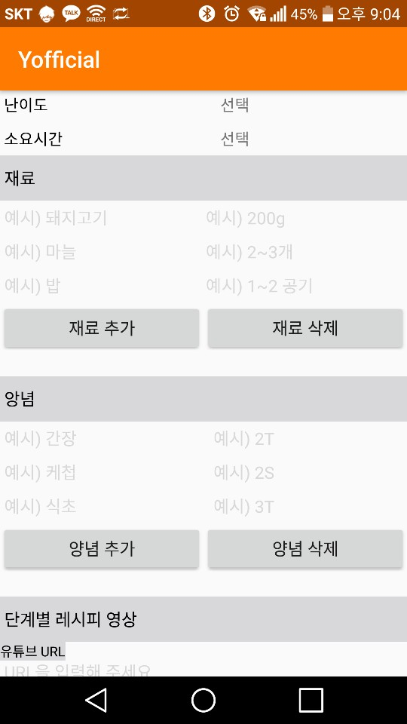
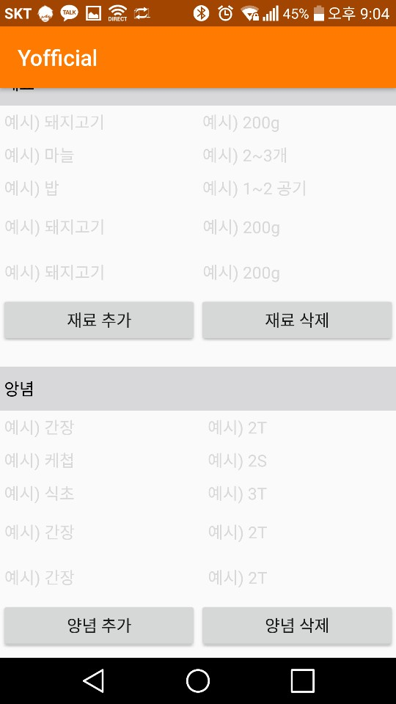
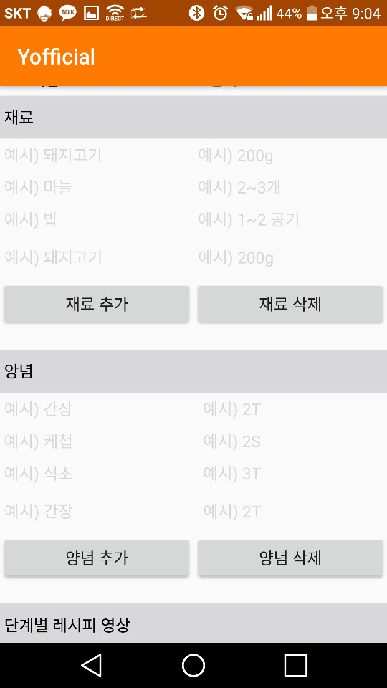
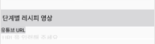
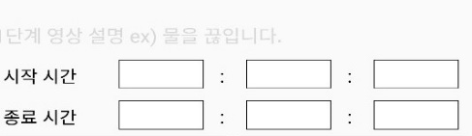


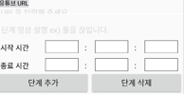
Progression
03
Progression of UI
Click!
Click!
Insert
Remove
Click!
Click!
Click!
Click!

Slide 6
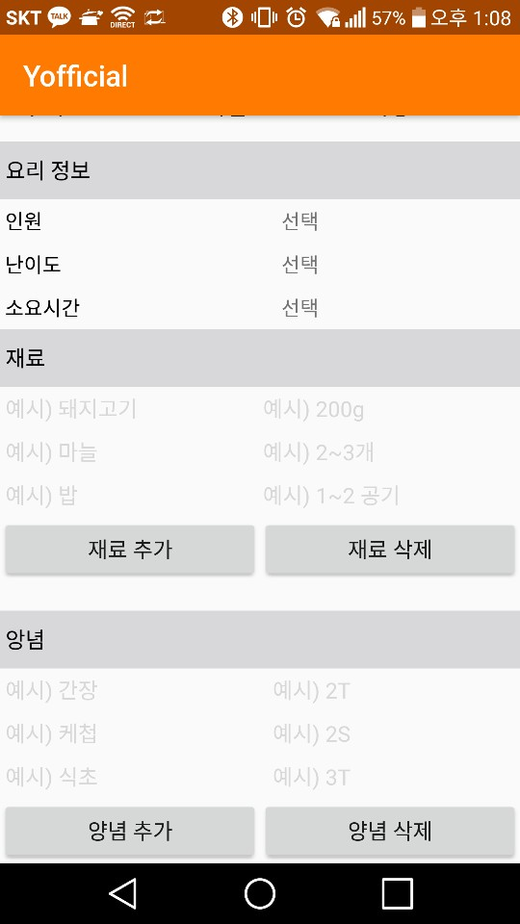
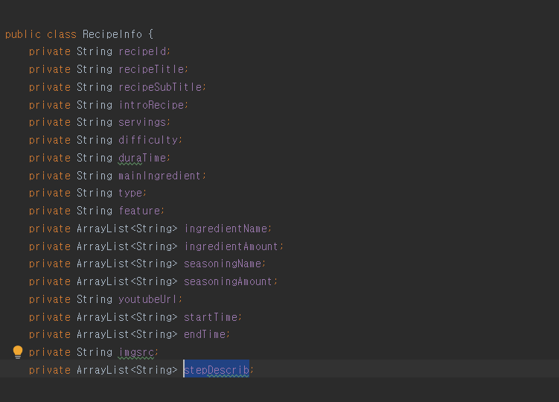
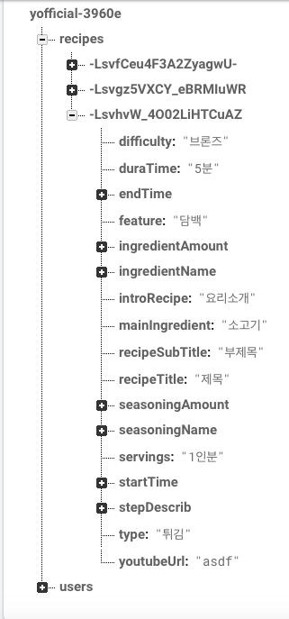
Progression
04
Progression of UI
Create Recipe View
Class storing recipe info
Store them into DB

Slide 7
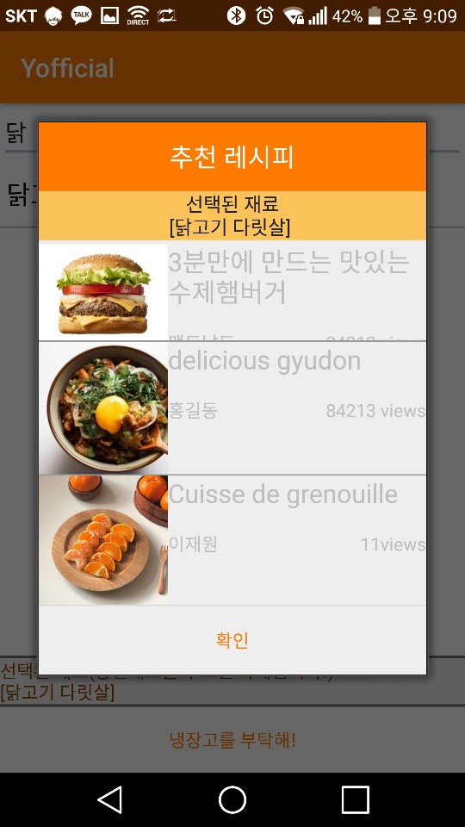
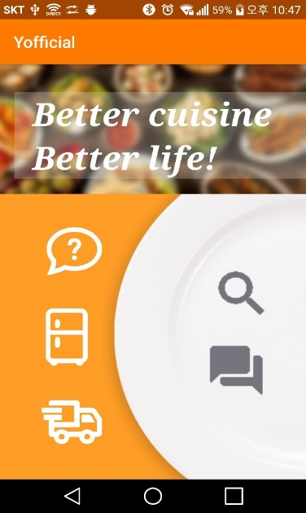
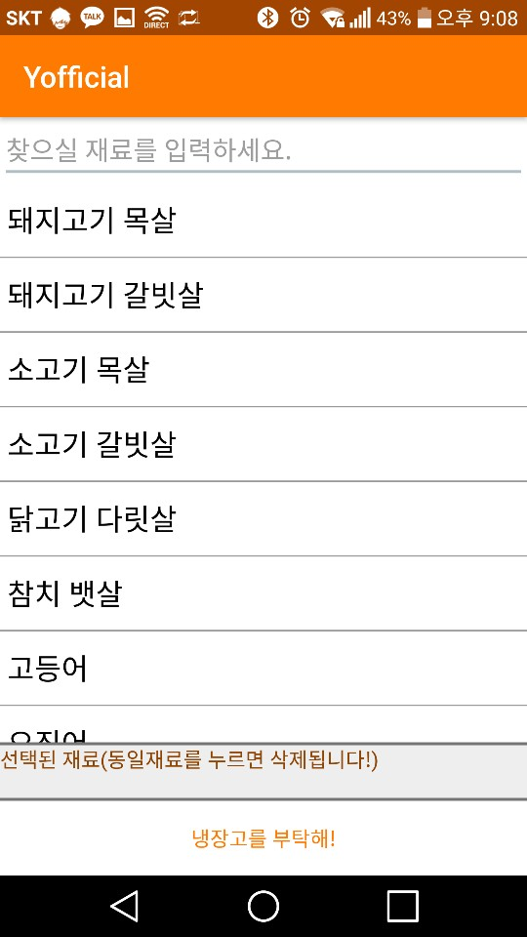
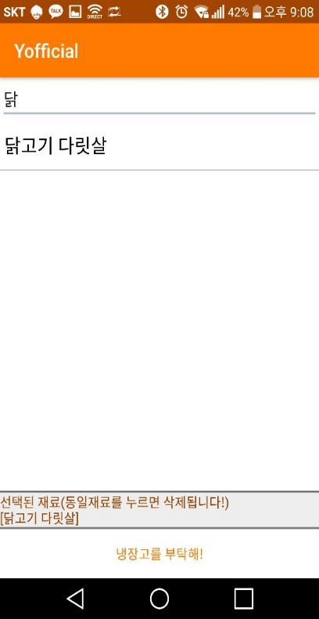
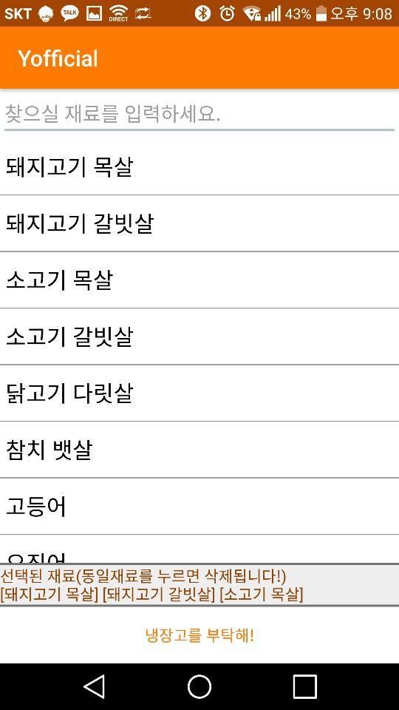
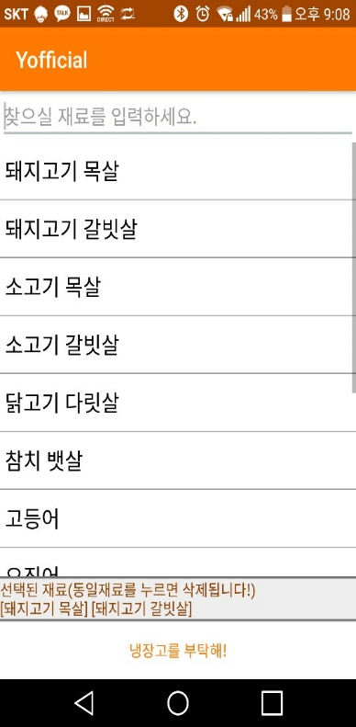
Progression
05
Progression of Functions
Start Screen
Searching
Item clicked
Item reclicked

Slide 8
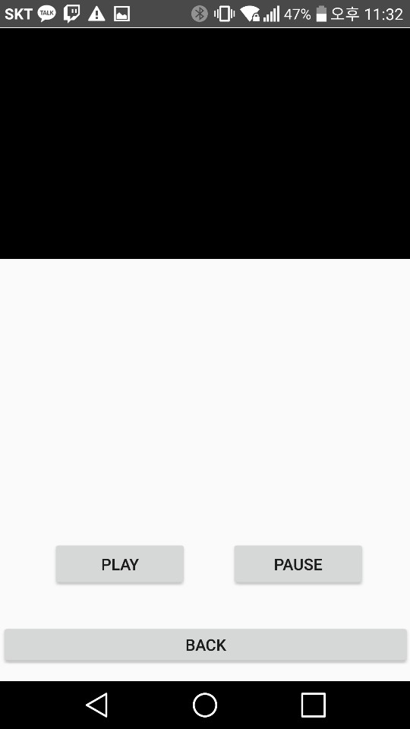
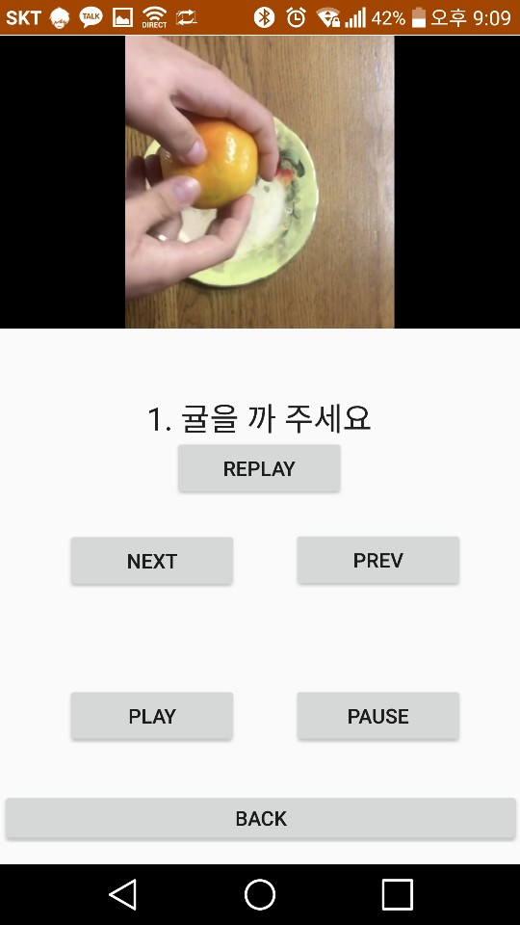
Progression
06
Progression of Functions
Interlocking with voice recognition

Slide 9
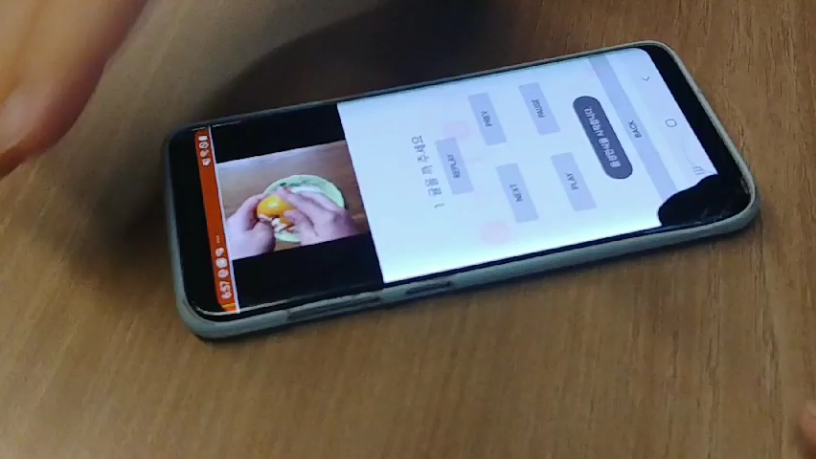
Progression and Changes with feedbacks
07
Progression of functions

Slide 10
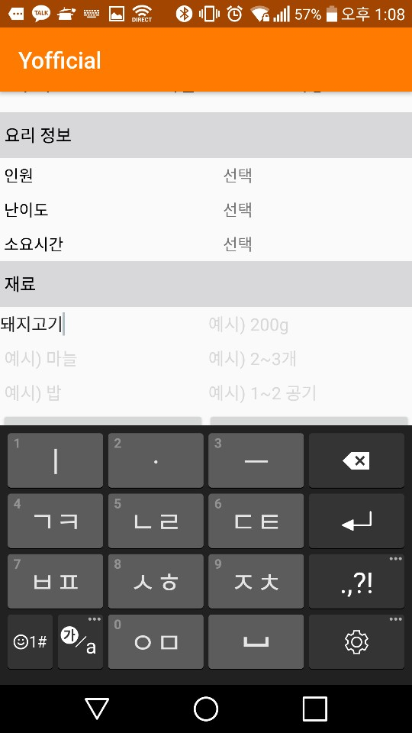


Trouble Shooting
08
Trouble Shooting
삼겹살 200g
돼지고기 삼겹살 200g
Have to make classification of words!

Slide 11
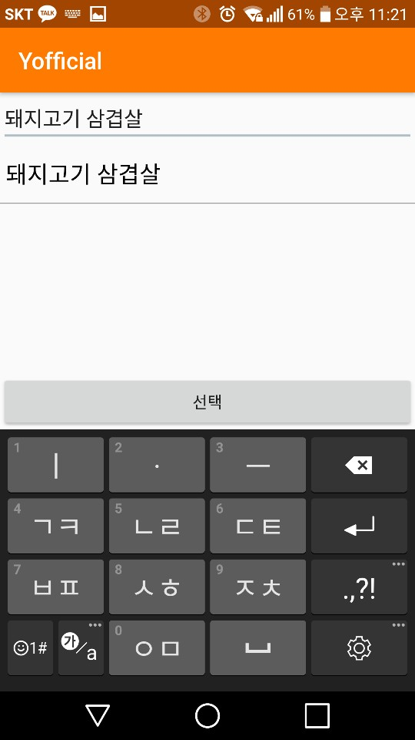
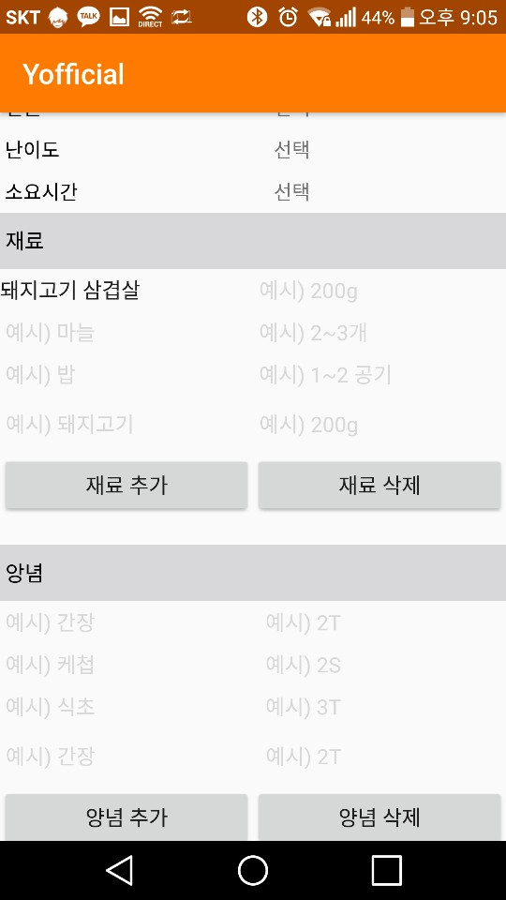
Trouble Shooting
09
Trouble Shooting
Click!

Slide 12
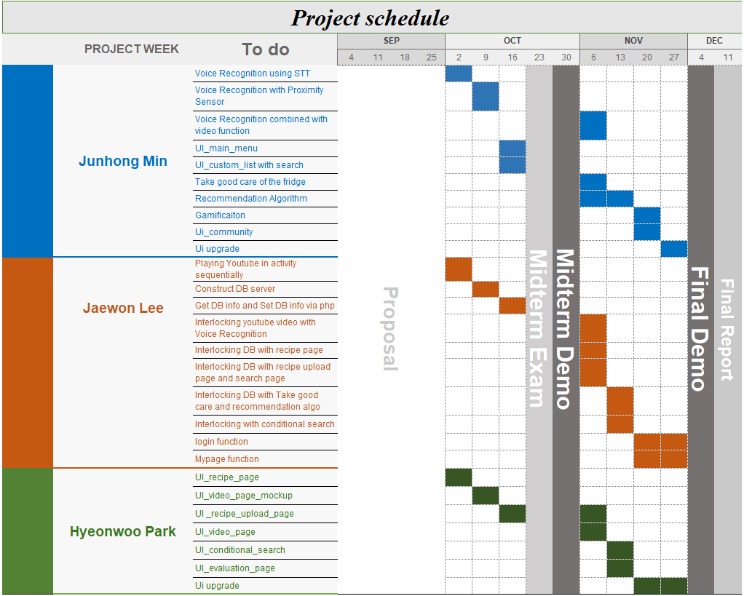
Schedule
10
Schedule

Slide 13
The end
Thank you

